Slide 1

A
Presentation
On
“Automatic Hydroponics Using IoT”
Presented
By
Ms. Sadaf R Shipai
Mr. Pratik R Waghmode
Mr. Prashant P Kale
Under the guidance of
Mrs. Pranjali Deshmukh
Professor, TCOER, Pune.

Slide 2
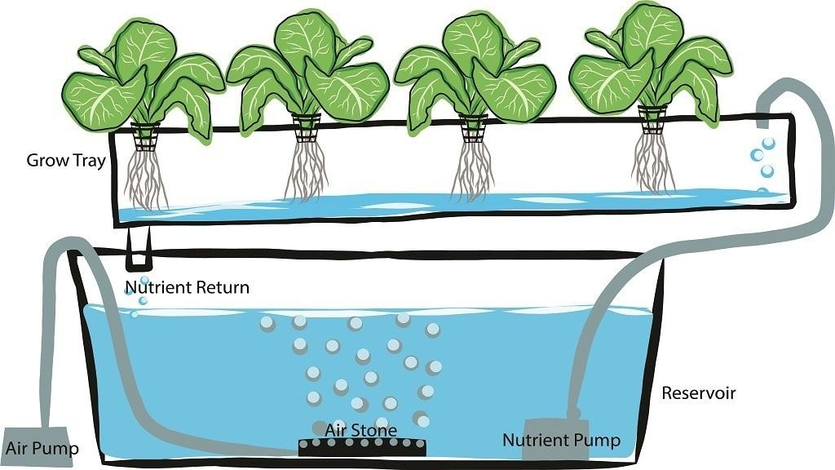
“Automatic Hydroponics Using IoT”

Slide 3
OUTLINE
Introduction
Literature survey
Components
Block diagram
Advantages
Limitations
Applications
Future scope
References

Slide 4
INTRODUCTION
The term Hydroponics was acquired from the Greek words ‘hydro’ means water and ‘ponos’ means labour.
Hydroponic is a method where the crops are grown in the absence of soil the nutrients that are acquired from the soil are given to them artificially.
The system can sense the hydroponic device's environment in a real-time it gives the stable way and also transmit the real time data which is temperature, humidity, light intensity, pH level.

Slide 5
LITERATURE SURVEY
In 1699 in England, hydroponics was used to grow mint plants without soil. During the 1600’s various methods were used to protect the horticultural crops from the cold. There are glass lanterns; bell rugs, cold frames and hot bed covered with glass are used.
The potassium in the nutrient solution affected the pigment concentrations and beta carotene content of tomato fruits in hydroponics.
Developers of this new technology, taking into account market profits, took the crops that appealed to the rich and privileged, the people who could afford the luxury of freshly harvested fruit in the greenhouse.

Slide 6
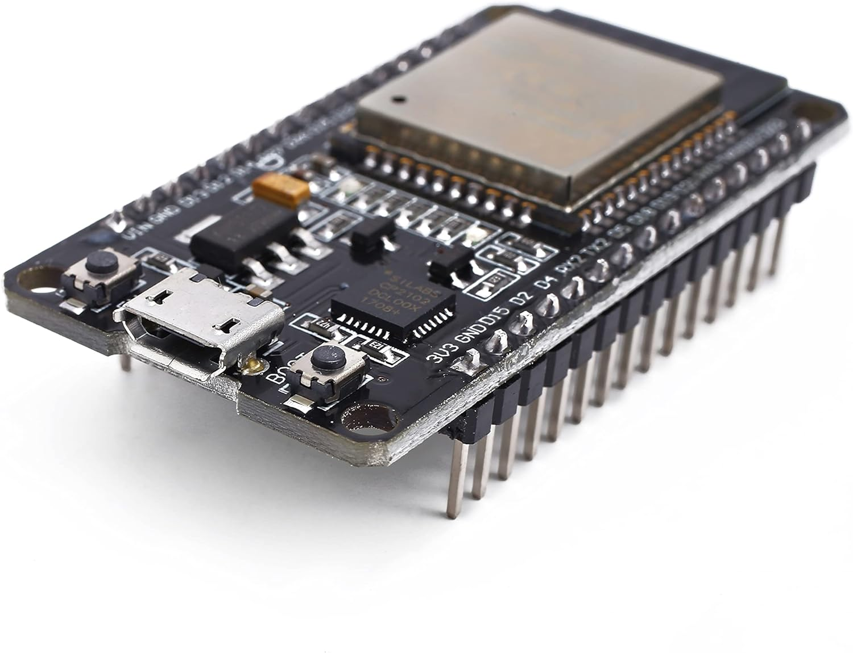
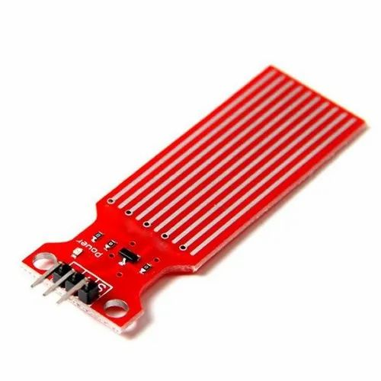
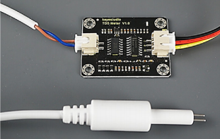
COMPONENTS
ESP32
Water temp. sensor
TDS sensor
Water Pumps
Temperature Sensor

Slide 7
BLOCK DIAGRAM
ESP32
MICRO
CONTROLLER
Water Pump
TDS sensor
Nutrient Pump
Water Level Sensor
GUI
Acid Pump
Temp. Sensor

Slide 8
WORKING
The ESP32 microcontroller automatically activates the water, phosphoric acid, and fertilizer pumps (N, P, and K). TDS,water level, and temperature sensors are also integrated into the developed hydroponics monitoring system.
Temperature, waterlimit, and EC levels are measurable parameters in a hydroponics monitoring system. During the hydroponics period oflettuce crop, was maintained at around 7° while the EC level was below 1800 ppm, and the temperature wasless than 27 °C.
The Wi-Fi interface on the hydroponic monitoring and management system enables the control and monitoring of thehydroponics parameters of agricultural systems using the GUI application.

Slide 9
ADVANTAGES
Higher yield achieved in a smaller space.
Soil-borne pests and diseases are eliminated.
No soils needed
Make better use of space and location
Climate control
Hydroponics is water-saving
Effective use of nutrients
Better growth rate

Slide 10
LIMITATIONS
Expensive to set up
Vulnerable to power outages
Requires constant monitoring and maintenance
Waterborne diseases
Problems affect plants quicker

Slide 11
Application
APPLICATION
APPLICATIONS
IOT allows interaction of machines and controlling the hydroponic system without human interaction.
innovative modernization of agriculture.
monitor and control crucial environmental factors such as temperature, humidity, and lighting.
By maintaining optimal conditions, IoT enables careful cultivation, accelerates plant growth, and boosts overall greenhouse productivity

Slide 12
FUTURE SCOPE
India’s hydroponic market is expected to grow at a Compound Annual Growth Rate of 13.53 per cent between 2020 and 2027. In comparison, the growth in the global hydroponic industry is estimated at just 6.8 per cent.
This market of products of hydroponic farming in India consists of consumers who are health conscious and will readily pay a premium for organically grown produce that is fresh, safe, and healthy.

Slide 13
REFERENCES
Mark Griffiths” The Design and Implementation Of a Hydroponics Control System” M.S theses, Dept. of Information Technology, Oulu University of Applied Sciences, Finland.,2014.
Carlos A.P.camara Automated system developed to control pH and concentration of nutrient solution evaluated in hydrophonic lettuce, Department ofChemistry, State University of Londrina,Brazil,2012.
Satoru YAMAGUCHI; Yoshihiko TAKAHASHI; Takeharu HAYASHI- Small indoor hydroponic system with renewable energy,2018.
Gabriel J. Useche Ossa ; Carolina García Montoya ; Mónica Ayde Vallejo Velásquez- Control and monitoring of a stevia plantation in a hydroponic system,2017.

Slide 14
THANK YOU!!!

